Slide 1
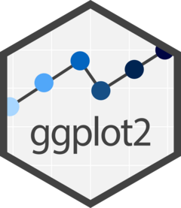
Visualizing Data
in R using ggplot2
Lauren Nichols
Center for Data and Visualization Sciences – Duke Libraries
Lmn7@duke.edu
Sept 2025

Slide 2





Data Visualization Specialists
Lauren
Nichols
McCall
Pitcher
Drew
Keener
mapping
Eric
Monson
askdata@duke.edu

Slide 3
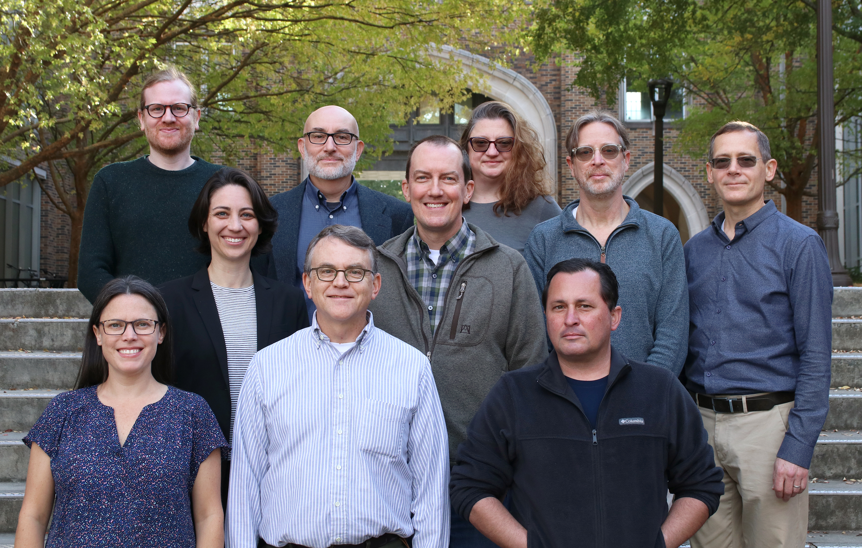
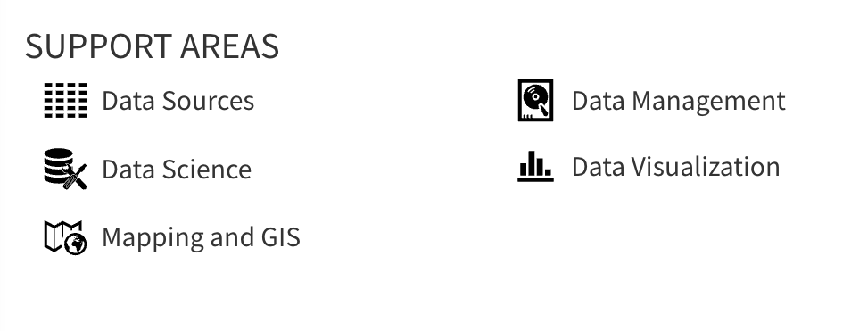
Center for Data & Visualization Sciences (CDVS)
AskData@duke.edu
Notes:
We offer workshops and individual consultation

Slide 4
“gg” in ggplot2 stands for
“Grammar of Graphics”
Notes:
(move it over)

Slide 5
Data
Aesthetics
Geometries
Statistics
“gg” in ggplot2 stands for
“Grammar of Graphics”
Graphics are built by layering elements
Scales
Themes
Notes:
framework that follows a layered approach constructing visualization. It allows us to buid visualizations in a structured and methodical way.

Slide 6
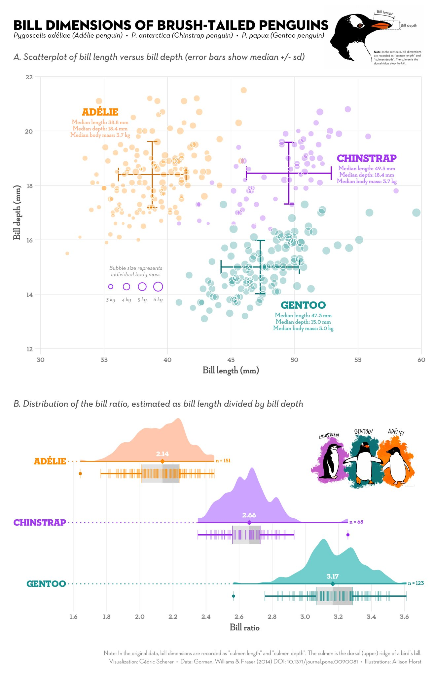
Notes:
Versatile – customize visualizations
Publication ready graphics
(or at least pretty close to it)
Integration with analysis in R
Succinct

Slide 7
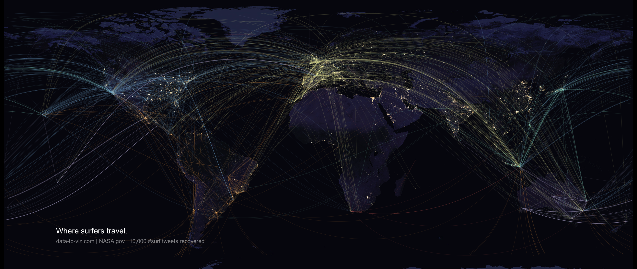
Notes:
Bespoke figures

Slide 8
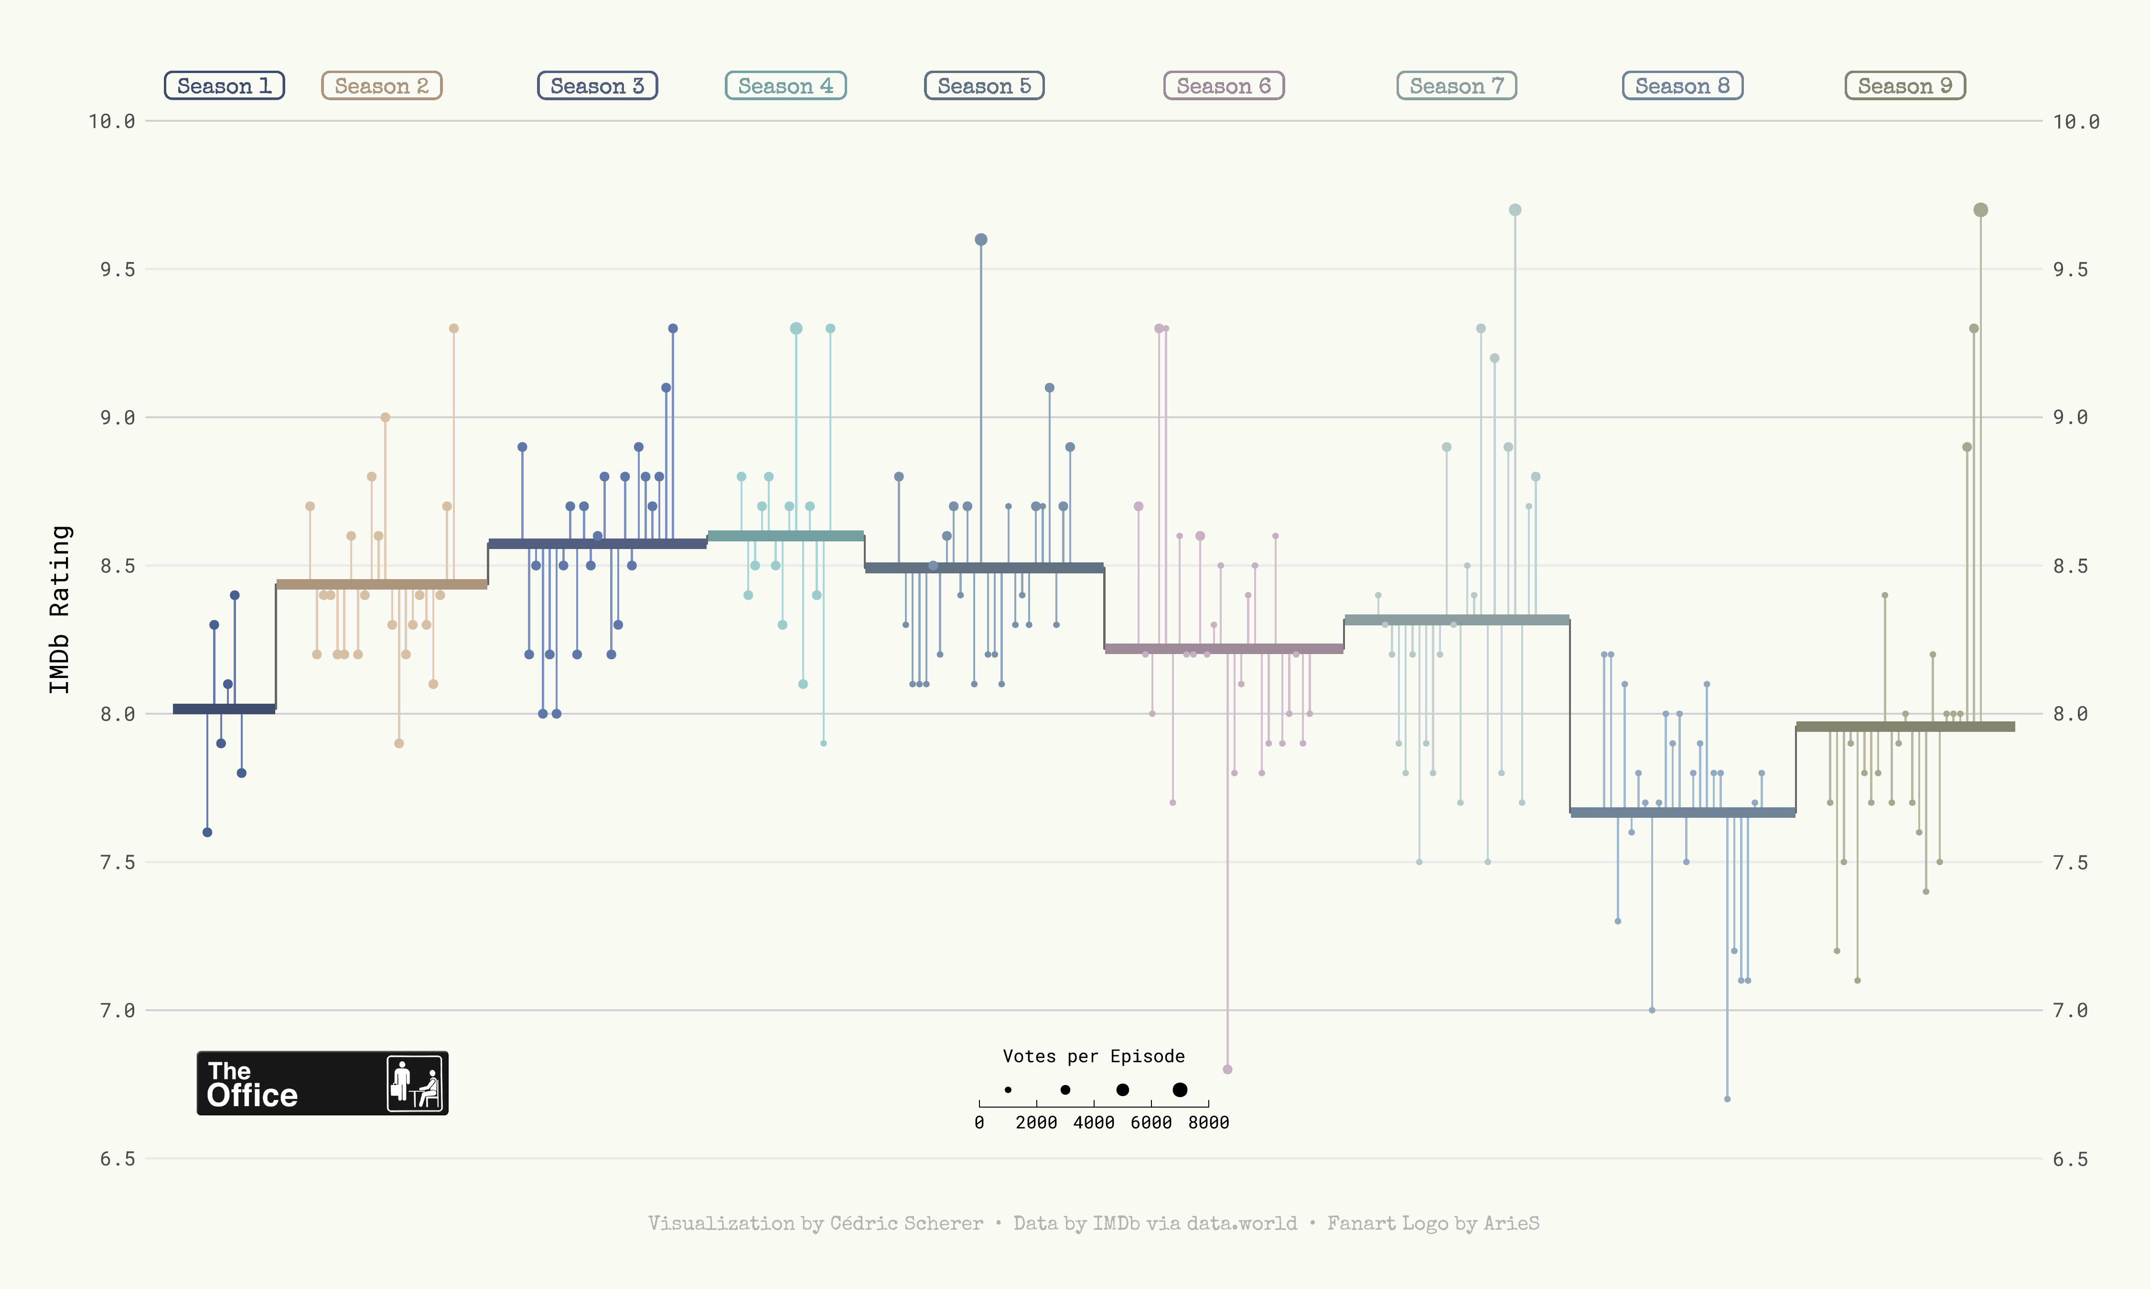

Slide 9
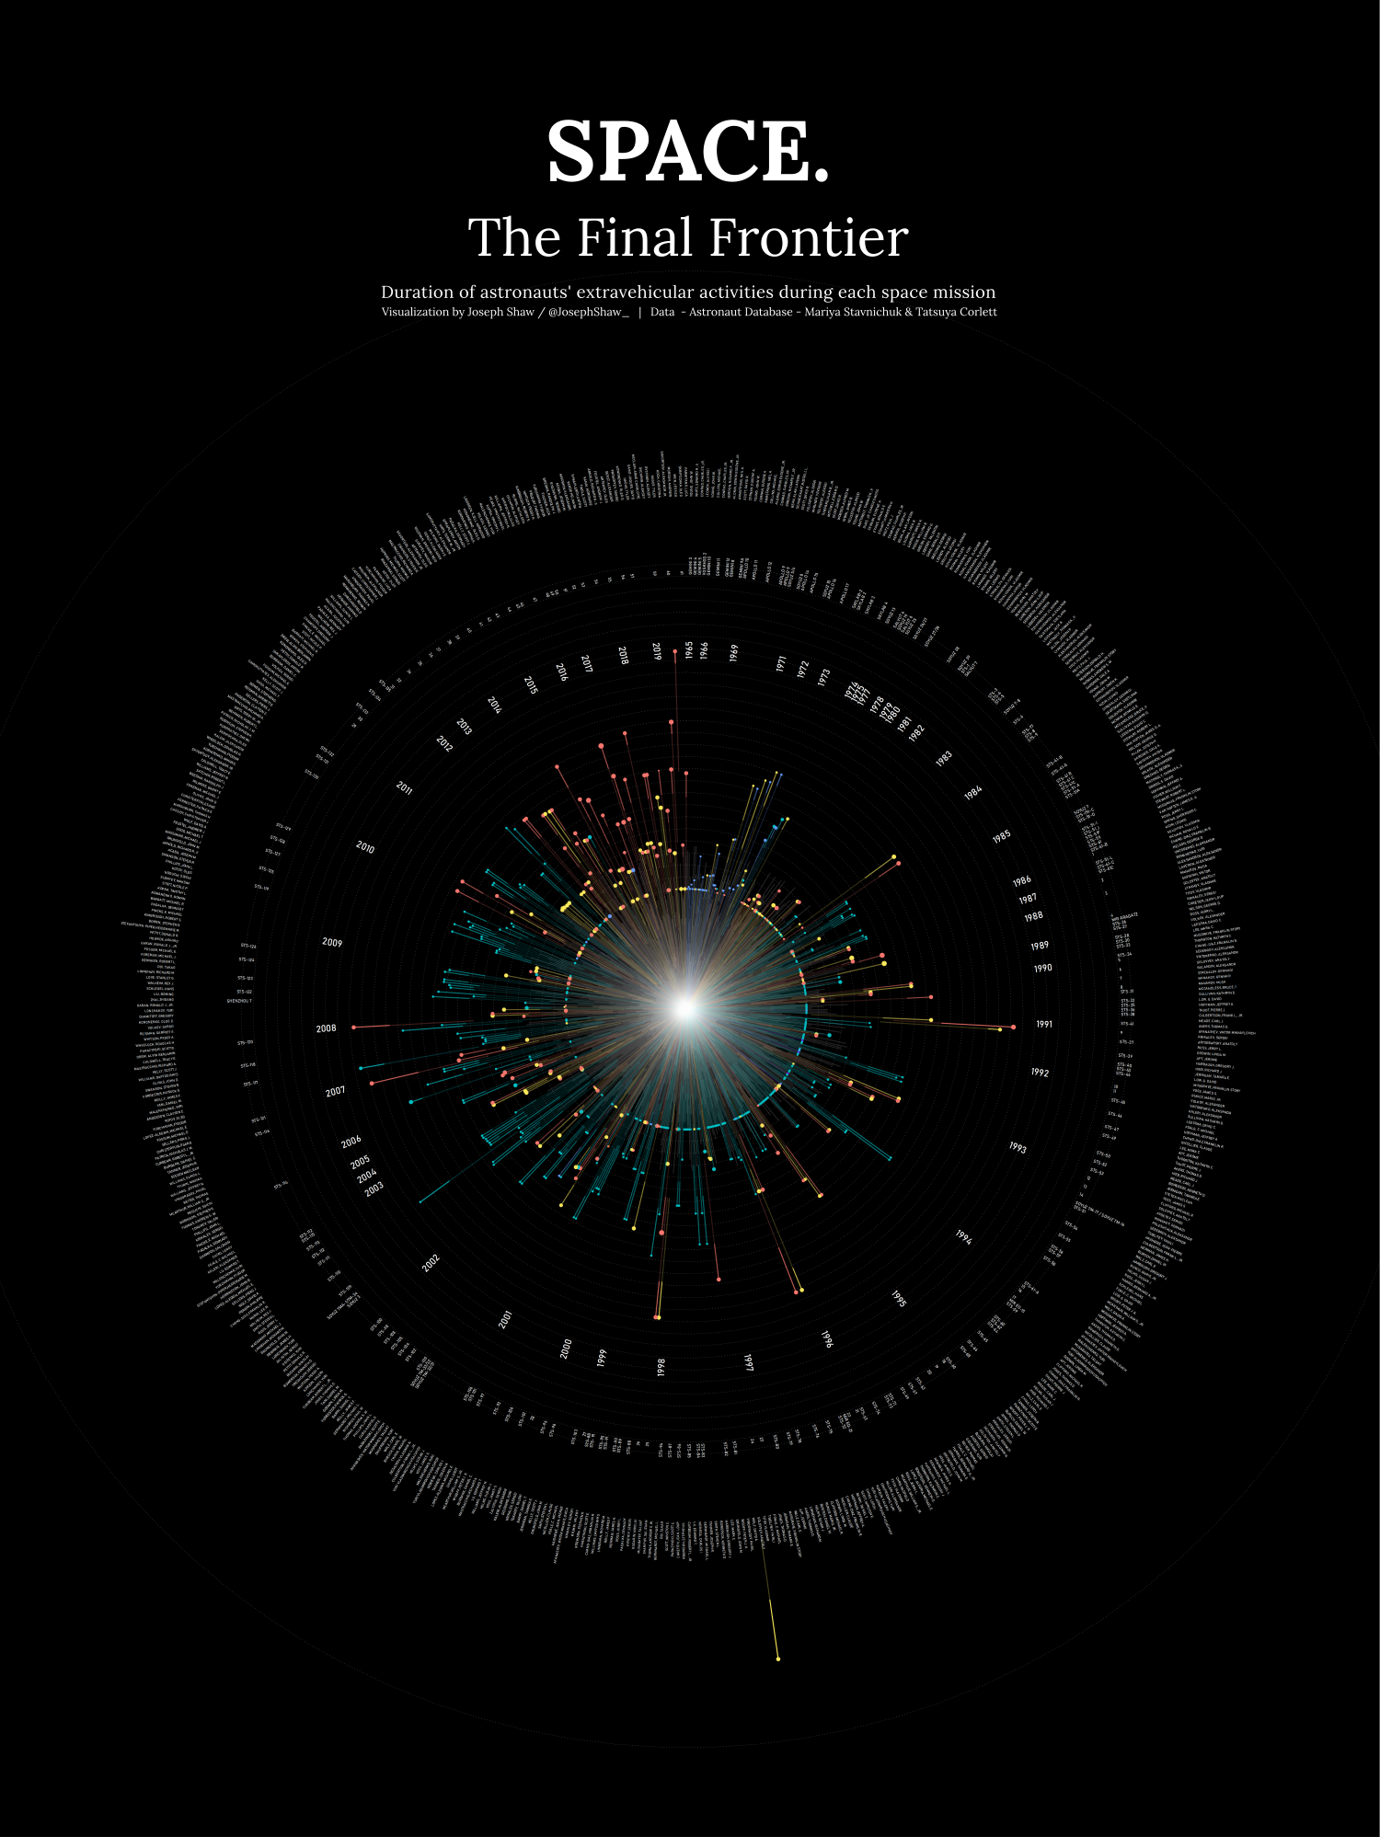
github.com/joseph-shaw/tidytuesday/

Slide 10
github.com/joseph-shaw/tidytuesday/

Slide 11
Data
ggplot(
data = yourdata
,
Aesthetics
mapping = aes(x axis, y axis)
) +
geometry function
+
Geometries
statistics function
+
Statistics
scales function
+
themes function
Scales
Themes
Notes:
method chaining with a +

Slide 12
Data
ggplot(
data = yourdata
,
Mapping
mapping = aes(x axis, y axis)
) +
geometry function
+
Geometries
statistics function
+
Statistics
scales function
+
themes function
Scales
Themes
Notes:
method chaining with a +

Slide 13
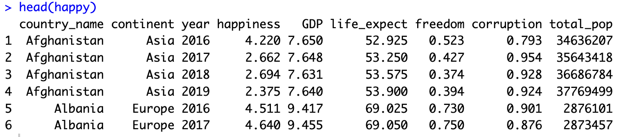
ggplot(
data = happy
,
aes(GDP, happiness)
)+
geometry function

Slide 14
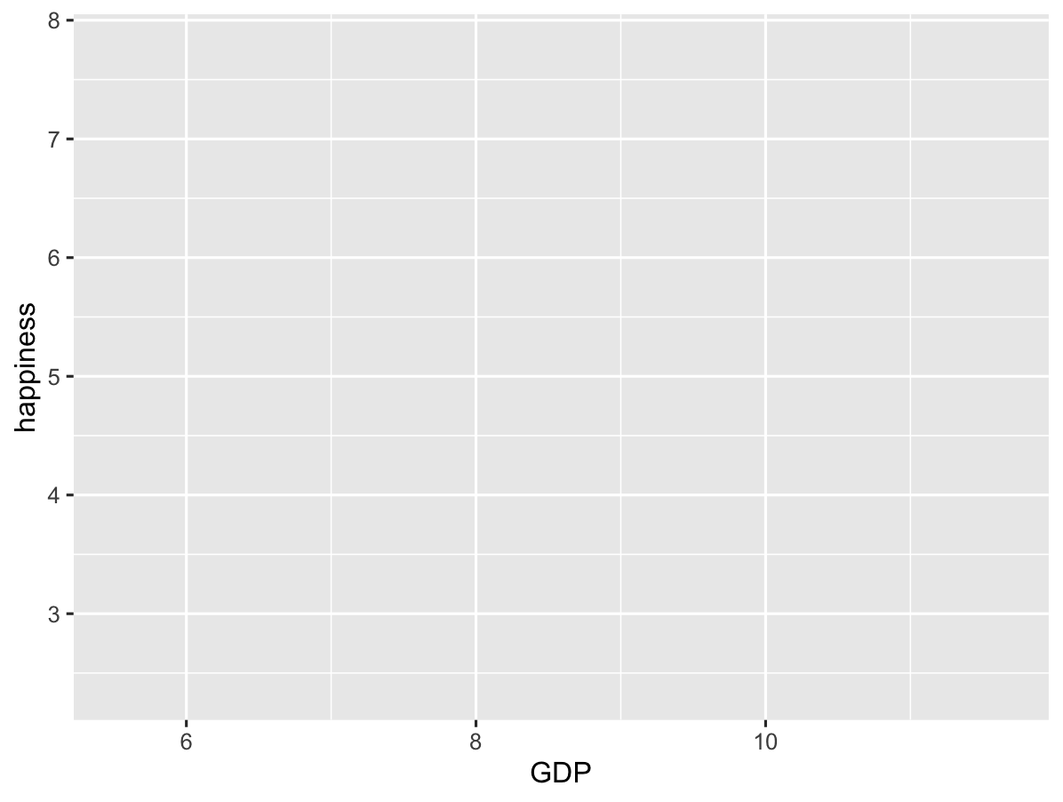
ggplot(
data = happy
,
aes(GDP, happiness)
)+
geom_point()

Slide 15
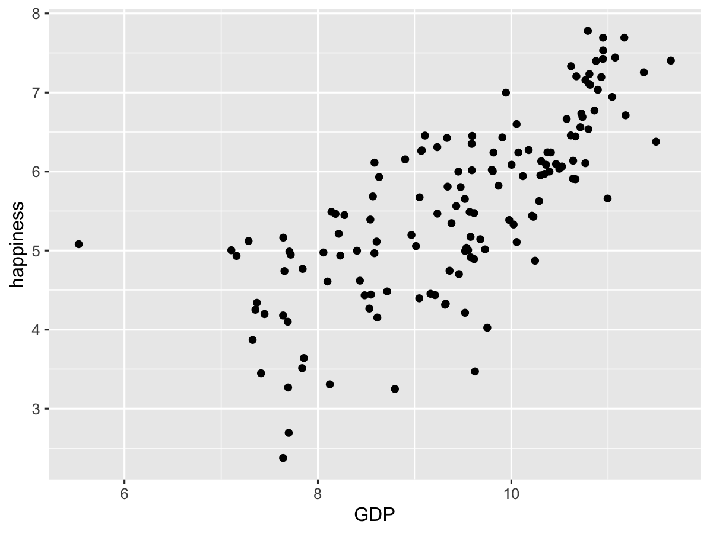
ggplot(
data = happy
,
aes(GDP, happiness)
)+
geom_point()

Slide 16
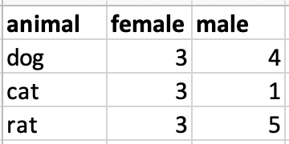
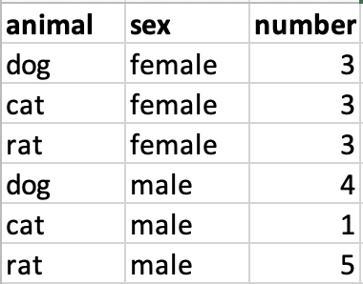
Data Format
Wide data
Long data

Slide 17
Data Format
Wide data
Long data
f

Slide 18
Data Format
Wide data
Long data
f
Long_data <- Wide_data |>
pivot_longer(names_to = sex,
values_to = number)

Slide 21
Data
,
ggplot(
data = yourdata
,
Aesthetics
aes(x axis, y axis)
) +
Geometries
geometry function
Notes:
method chaining with a +

Slide 22
Data
,
ggplot(
data = yourdata
,
Aesthetics
aes(x axis, y axis)
) +
Geometries
geometry function
ggplot(
data = happy
,
aes(x=GDP, y=happiness)
) +
geom_point()
Notes:
method chaining with a +

Slide 23
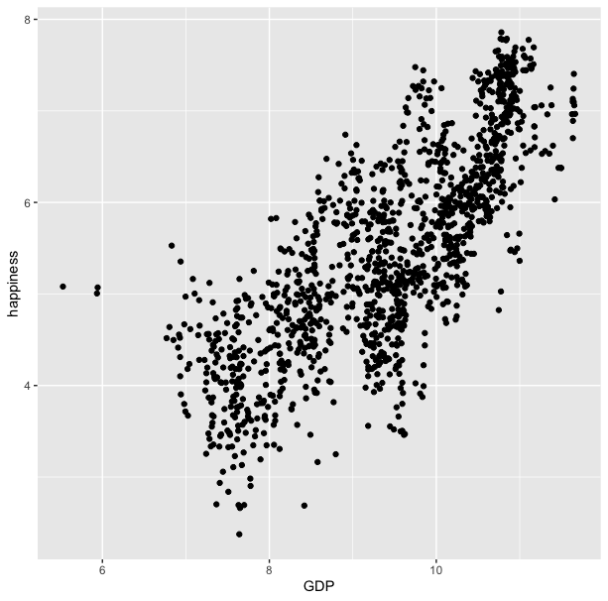
ggplot(
data = happy
,
aes(x=GDP, y=happiness)
) +
geom_point()

Slide 24
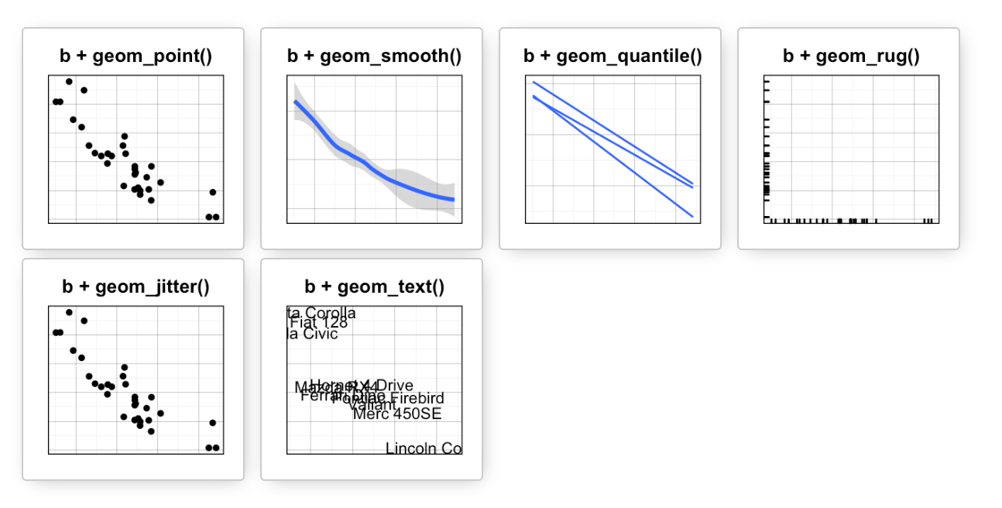
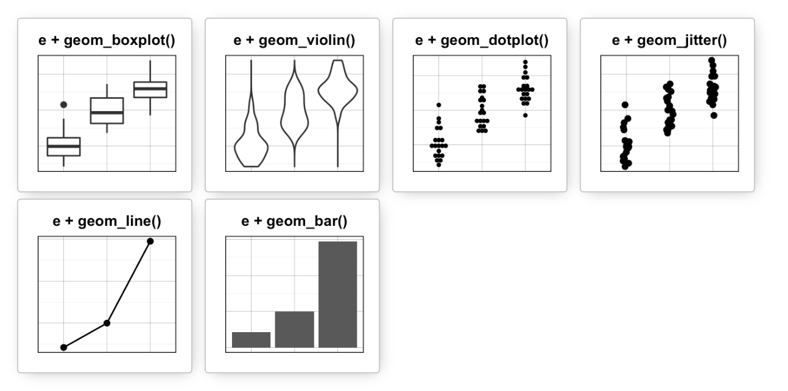
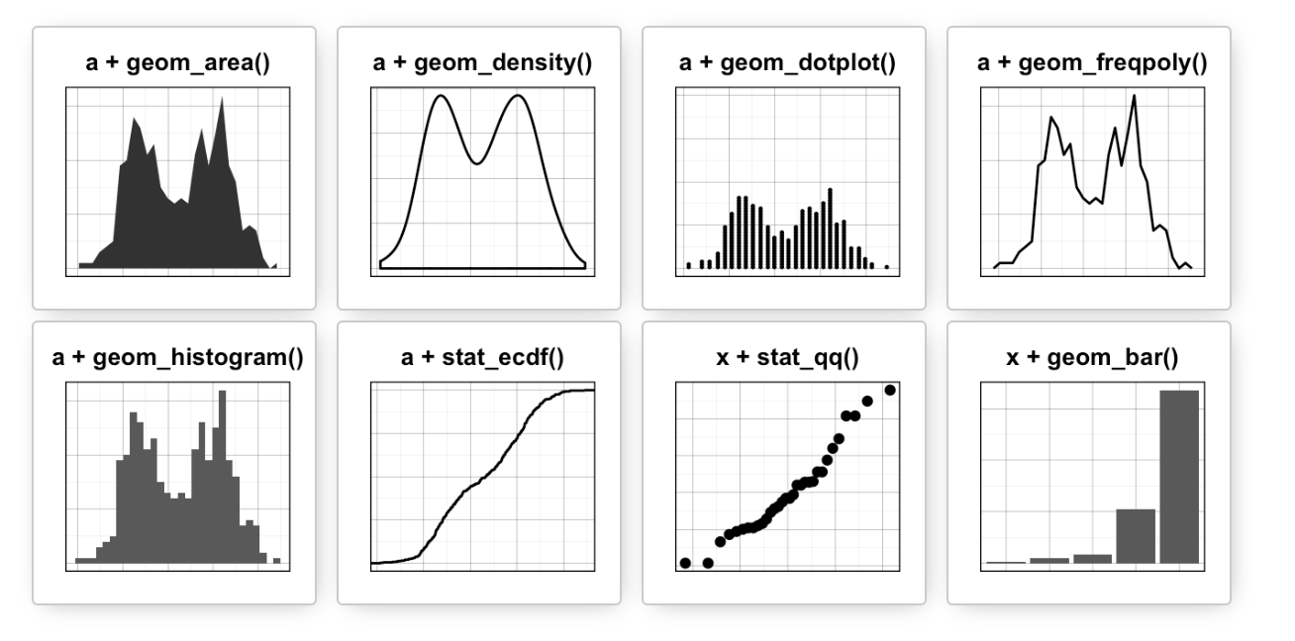
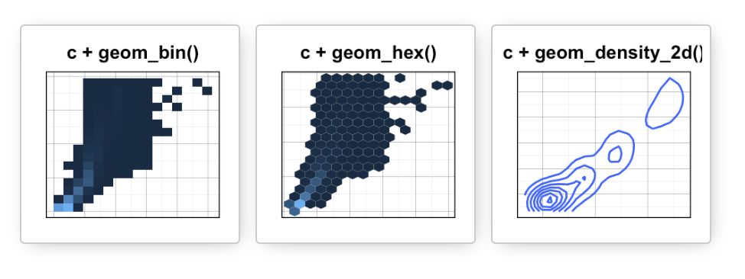
Data
Aesthetics
Geometries
Statistics
Scales
Themes
Exporting

Slide 25
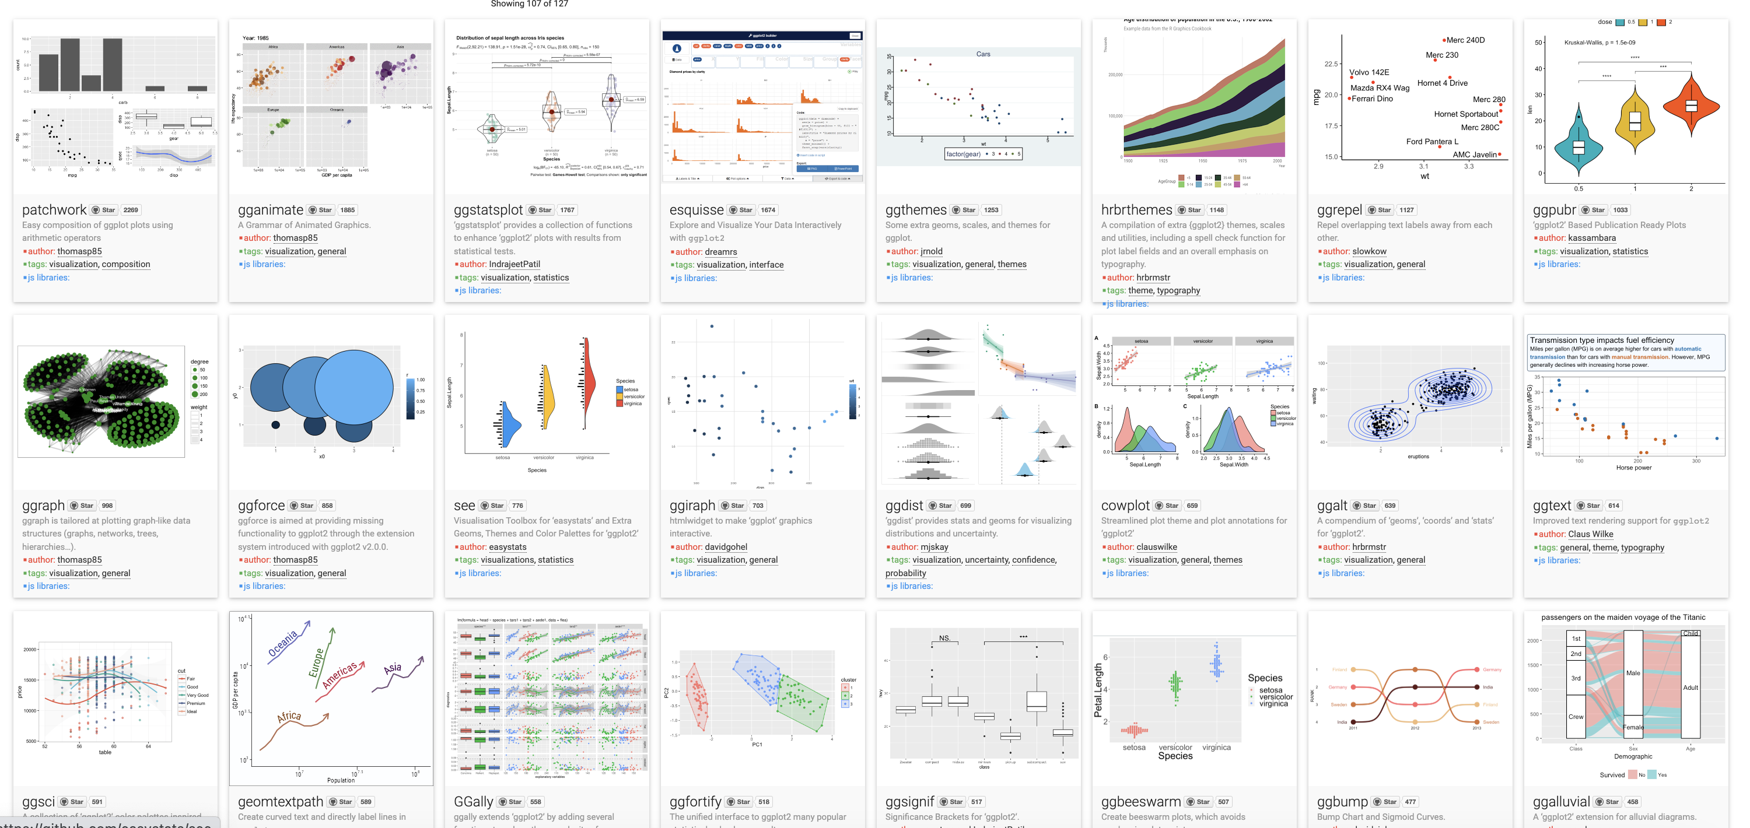
Over 120 ggplot2 extension libraries

Slide 27
ggplot(
,
data = happy
aes(GDP, happiness)
) +
geom_point()
“and then…”
dplyr %>% or |>
ggplot +

Slide 28

ggplot(data = happy, aes(x=GDP, y=happiness))+
geom_point()

Slide 29
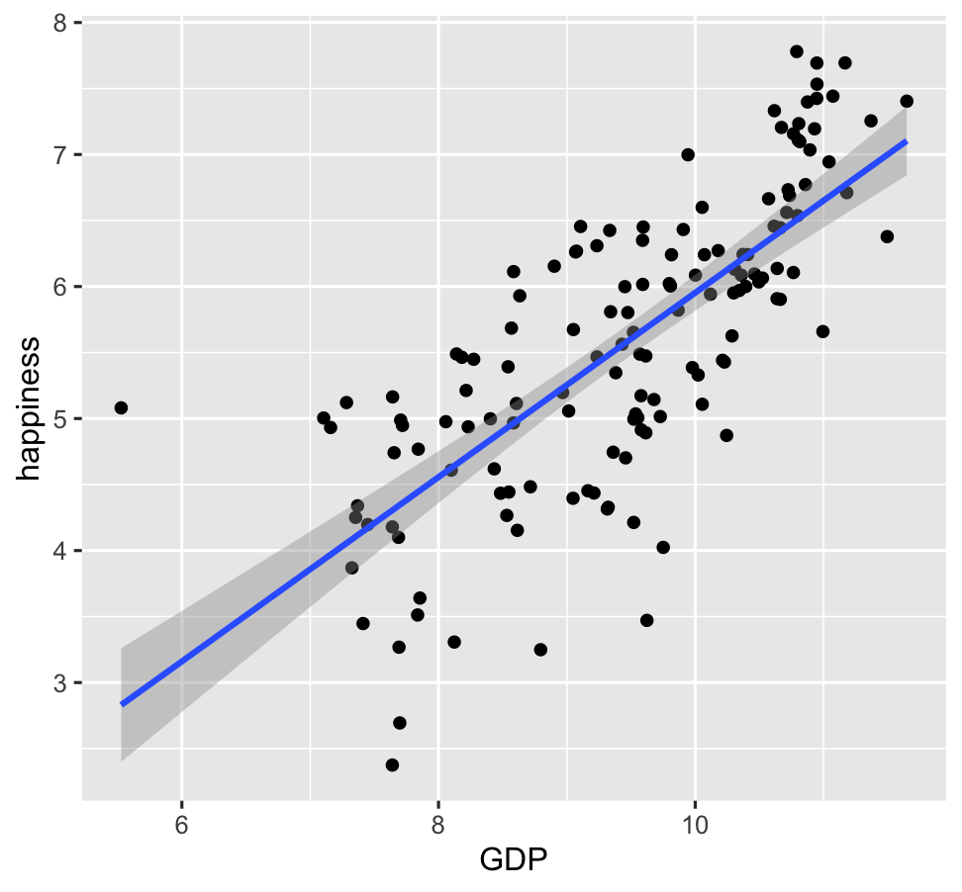
ggplot(data = happy, aes(x=GDP, y=happiness))+
geom_point()+
geom_smooth()

Slide 30
ggplot(
data = happy
,
) +
aes(x=GDP, y=happiness)
geom_point()

Slide 31
ggplot(
data = happy
,
aes(x=GDP, y=happiness)
) +
geom_point()
Notes:
ADD SLIDE BEF ORE WITHOUT Xs

Slide 32
ggplot(
data = happy
,
aes(x=GDP, y=happiness)
) +
geom_point()
ggplot(
happy
aes(GDP, happiness)
) +
,
geom_point()

Slide 33
ggplot(
data = happy
,
aes(x=GDP, y=happiness)
) +
geom_point()
ggplot(
happy
aes(GDP, happiness)
) +
,
geom_point()
ggplot(
) +
geom_point(
happy
aes(GDP, happiness)
,
)

Slide 34
ggplot(
data = happy
,
aes(x=GDP, y=happiness)
) +
geom_point()
ggplot(
happy
aes(GDP, happiness)
) +
,
geom_point()
ggplot(
) +
geom_point(
happy
aes(GDP, happiness)
,
)
,
happy
%>%
ggplot(
aes(GDP, happiness)
) +
geom_point()

Slide 35
ggplot(
data = happy
,
aes(x=GDP, y=happiness)
) +
geom_point()
ggplot(
happy
aes(GDP, happiness)
) +
,
geom_point()
ggplot(
) +
geom_point(
happy
aes(GDP, happiness)
,
)
,
happy
%>%
ggplot(
aes(GDP, happiness)
) +
geom_point()
These all produce the same figure!

Slide 36
Aesthetics define any data that gets mapped to geometry
(such as color, size, shape, etc.)
ggplot(data = yourData,
aes(x = xaxis,y = yaxis))+
geom_point()
Notes:
method chaining with a +

Slide 37
Aesthetics define any data that gets mapped to geometry
(such as color, size, shape, etc.)
ggplot(data = happy,
aes(x = happiness,y = GDP,
shape= ,
size= ,
col= ))+
geom_point()
Notes:
method chaining with a +

Slide 39
ggplot(happy, aes(GDP, happiness)) +
geom_point()

Slide 40
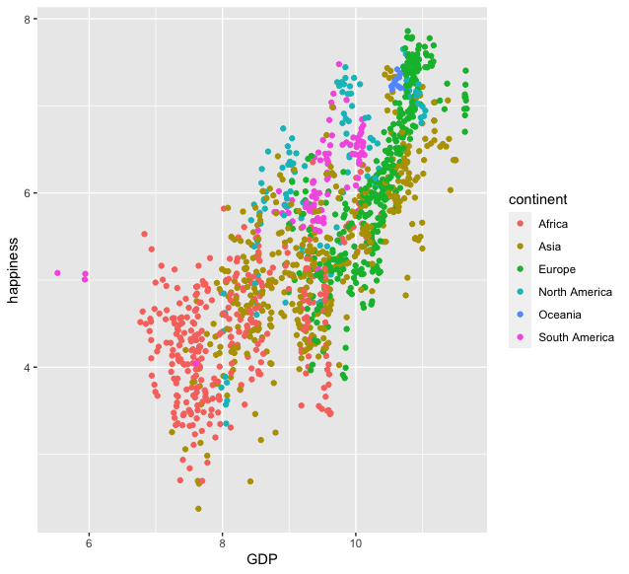
ggplot(happy, aes(GDP, happiness)) +
geom_point(aes(col=continent))

Slide 41
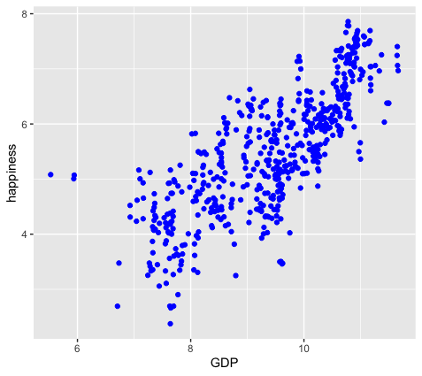
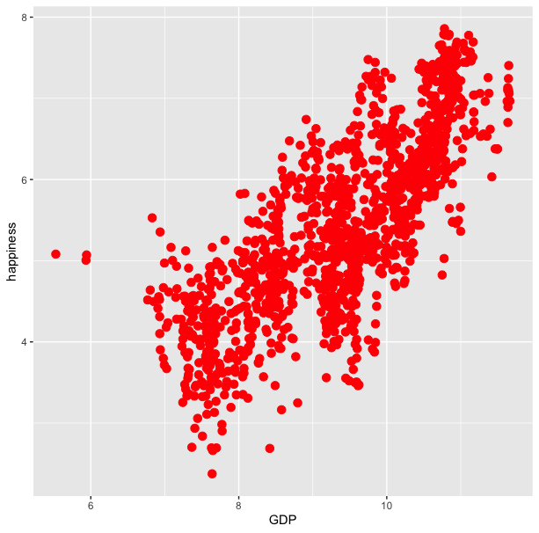
ggplot(happy, aes(GDP, happiness)) +
geom_point(aes(col=continent))
ggplot(happy, aes(GDP, happiness)) +
geom_point(col=‘blue’)

Slide 42
ggplot(happy, aes(GDP, happiness)) +
geom_point(aes(col=continent))
ggplot(happy, aes(GDP, happiness)) +
geom_point(col=‘blue’)
ggplot(happy, aes(GDP, happiness)) +
geom_point(aes(col=‘blue’))

Slide 43
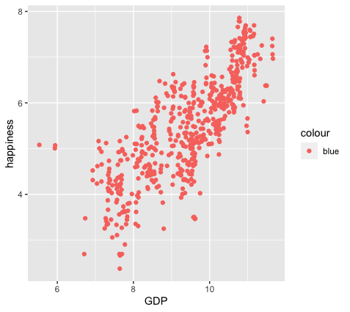
ggplot(happy, aes(GDP, happiness)) +
geom_point(aes(col=continent))
ggplot(happy, aes(GDP, happiness)) +
geom_point(col=‘blue’)
ggplot(happy, aes(GDP, happiness)) +
geom_point(aes(col=‘blue’))

Slide 44
colour
blue
blue
blue
blue
blue
blue
ggplot(happy, aes(GDP, happiness)) +
geom_point(aes(col=‘blue’))

Slide 45
ggplot(happy, aes(GDP, happiness)) +
geom_point()
We can also set conditional formatting.
e.g. Use different colors for points where happiness is > 5

Slide 46
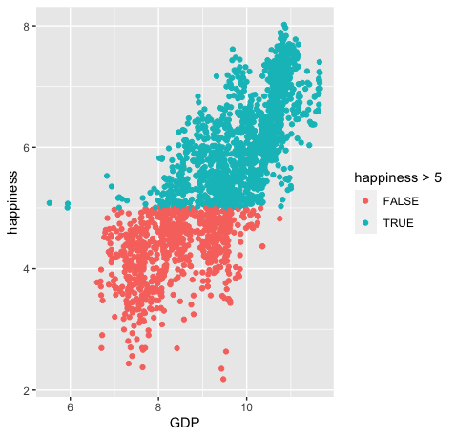
ggplot(happy, aes(GDP, happiness)) +
geom_point()
ggplot(happy, aes(GDP, happiness)) +
geom_point(aes(col=happiness > 5)

Slide 47
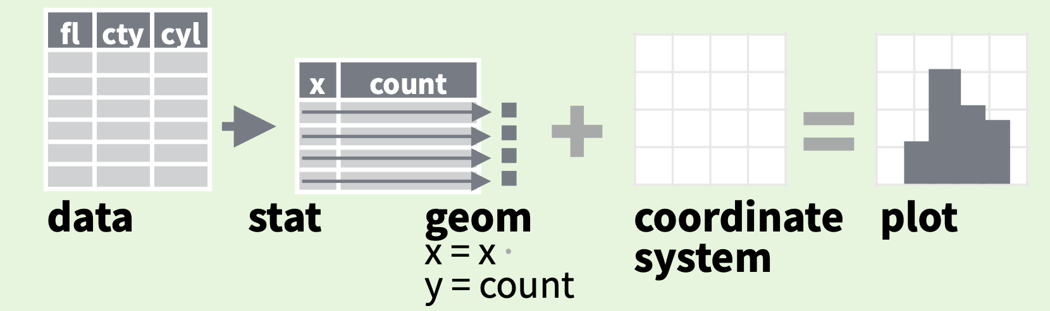
stats
Every geom function specifies a stat
Data
Aesthetics
Geometries
Statistics
Scales
Themes
Exporting

Slide 48
stats
Every geom function specifies a stat
Notes:
For example: If we wanted to make a bar plot that shows how frequently each of the continents is represented in our dataset.

Slide 49
stats
Every geom function specifies a stat
ggplot(happy, aes(continent)) +
geom_bar()
Notes:
ADD INFO ABOUT THE SILENT STAT=SUM

Slide 50
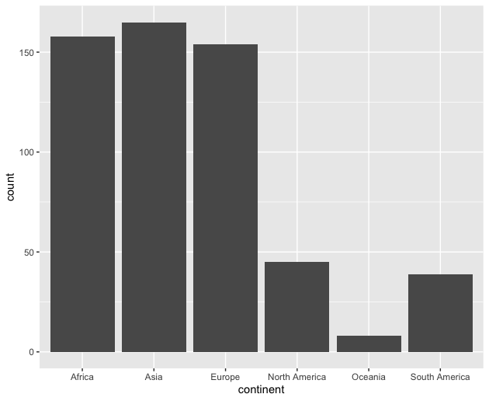
stats
Every geom function specifies a stat
ggplot(happy, aes(continent)) +
geom_bar()

Slide 51
Scales
Data
Scales permeate all aspects of plotting in ggplot2
Most defaults will be enough
BUT learning how to manipulate them will give you much more control.
Aesthetics
Geometries
Statistics
Scales
Themes
Exporting

Slide 52
Scales
Data
Scales permeate all aspects of plotting in ggplot2
Most defaults will be enough
BUT learning how to manipulate them will give you much more control.
Aesthetics
Geometries
Statistics
Scales
Themes
Exporting

Slide 53
Scales
Data
Scales permeate all aspects of plotting in ggplot2
Most defaults will be enough
BUT learning how to manipulate them will give you much more control.
Aesthetics
Geometries
Statistics
Scales
Themes
Exporting

Slide 54
Three kinds of scales you are most likely to use:
Axes Limits
Bins
Colors

Slide 55
Three kinds of scales you are most likely to use:
Axes Limits
Bins
Colors
Ill cover these during the live demo portion

Slide 56
Three kinds of scales you are most likely to use:
Axes Limits
Bins
Colors
I want to spend some time talking about color scales

Slide 57
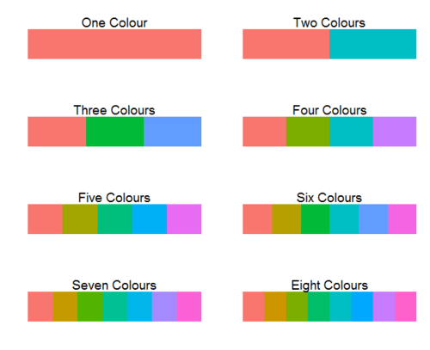
ggplot2 default colors for factors

Slide 58
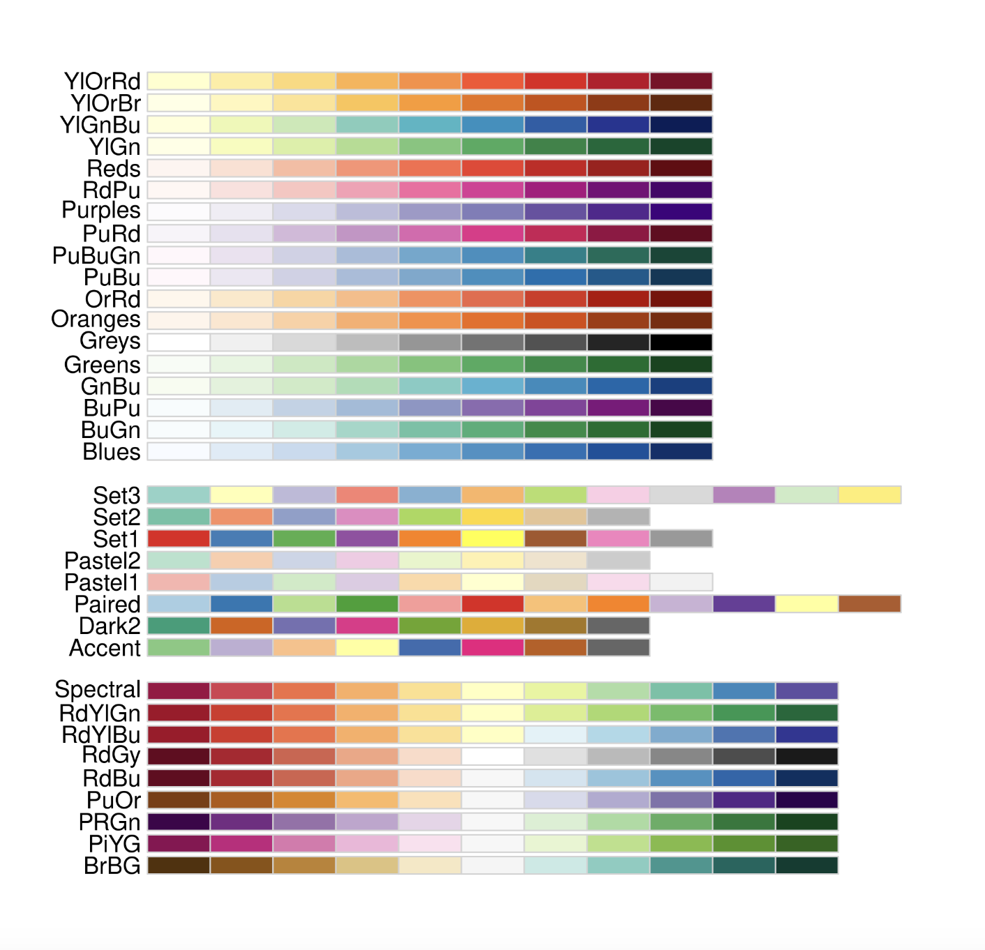
Brewer Scales
Monochrome scales
Qualitative scales
Divergent color scales
Notes:
ADD IMAGE OF DEFAULT COLOR SCALE

Slide 59
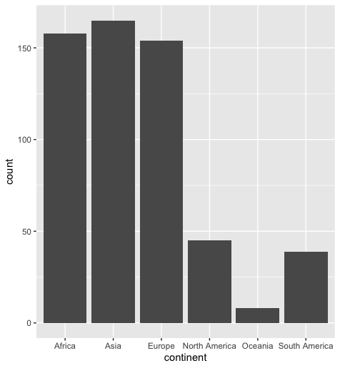
Brewer Scales
ggplot(happy, aes(GDP, happiness))+
geom_bar()
Notes:
take out col=continent

Slide 60
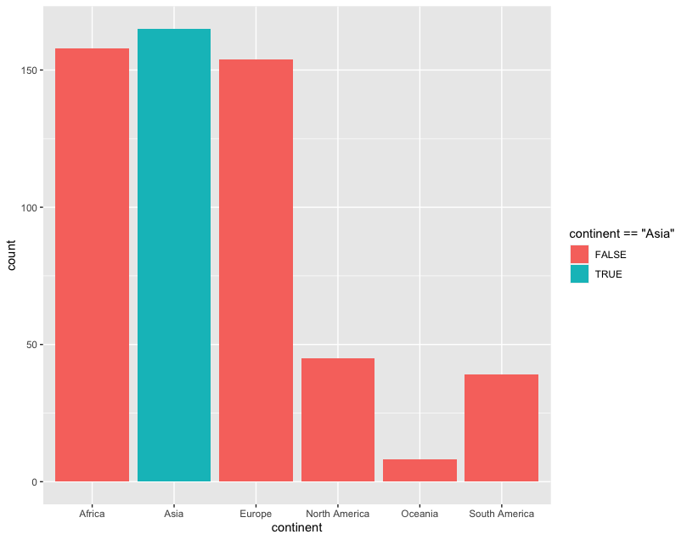
Brewer Scales
ggplot(happy, aes(GDP, happiness))+
geom_bar(aes(fill=continent==‘Asia’))
Notes:
Take

Slide 61
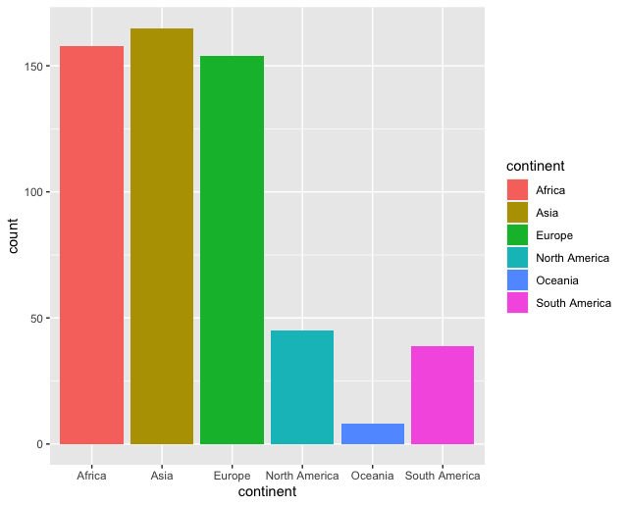
Brewer Scales
ggplot(happy, aes(GDP, happiness))+
geom_bar(aes(fill=continent==‘Asia’))
Notes:
USE A DIFFERENT EXAMPLE USING A HIGHLIGHT COLOR

Slide 62
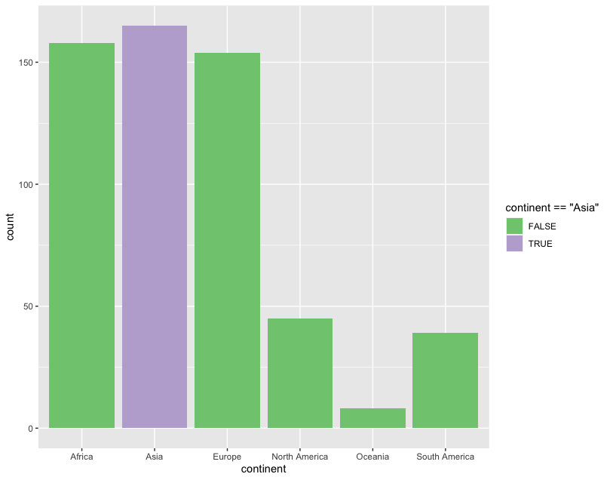
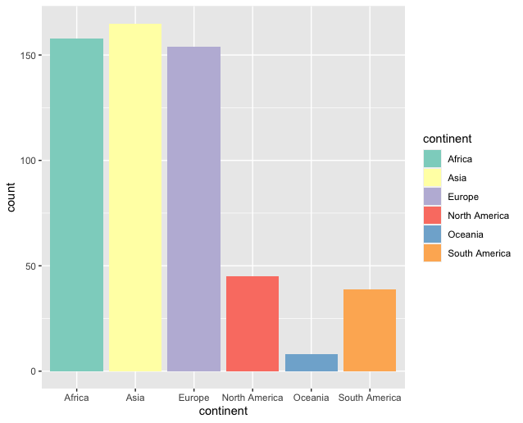
Brewer Scales
ggplot(happy, aes(GDP, happiness))+
geom_bar(aes(fill=continent==‘Asia’))+
scale_fill_brewer(palette = “Accent”)

Slide 63

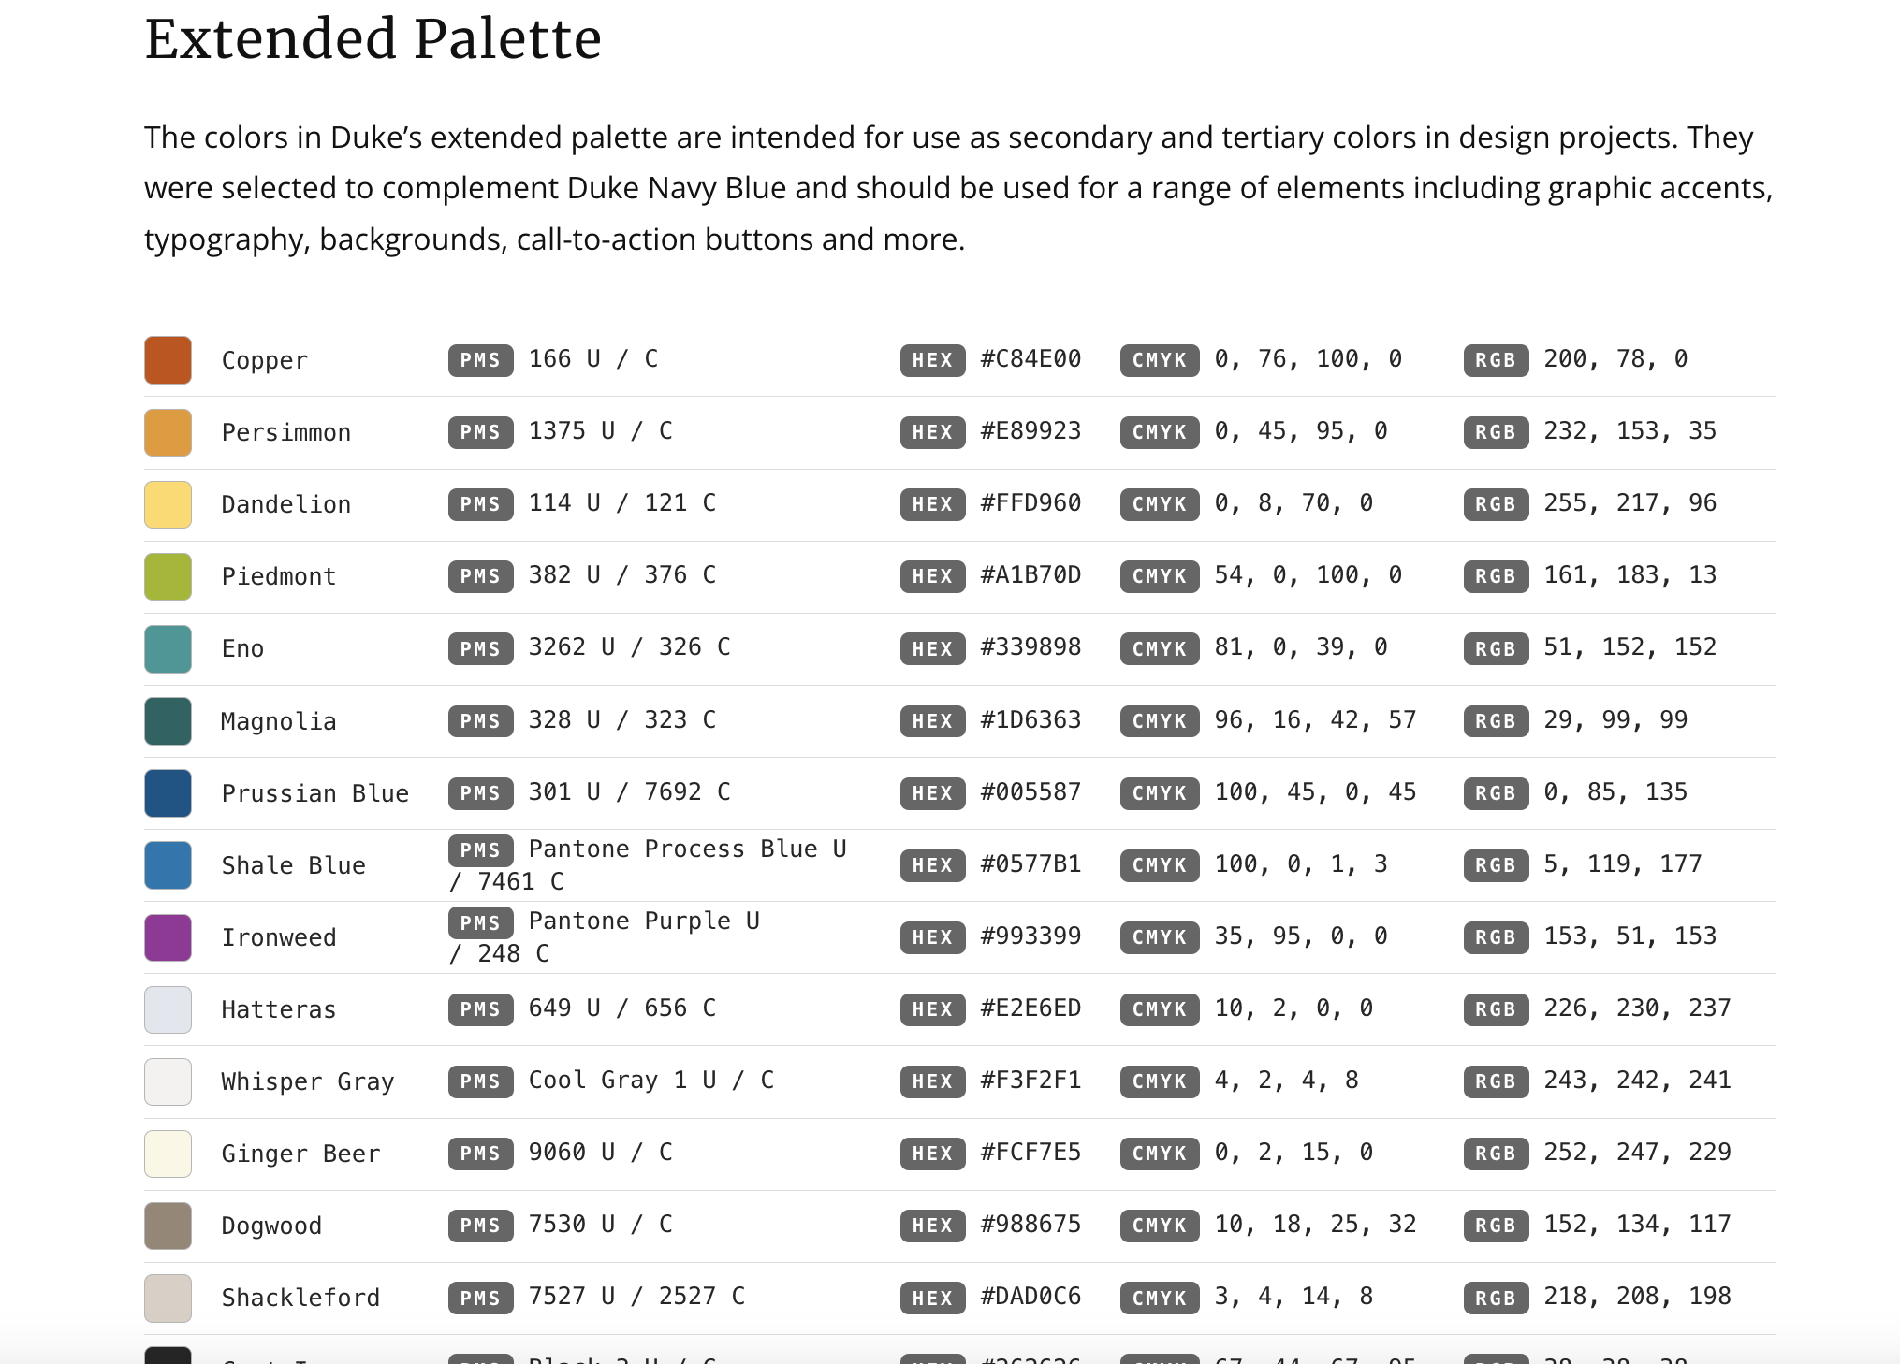
http://brand.duke.edu/colors

Slide 64

http://brand.duke.edu/colors

Slide 65
Custom Scales
Notes:
USE A DIFFERENT EXAMPLE. Add slides showing how you can use neutral and highlight colors

Slide 66
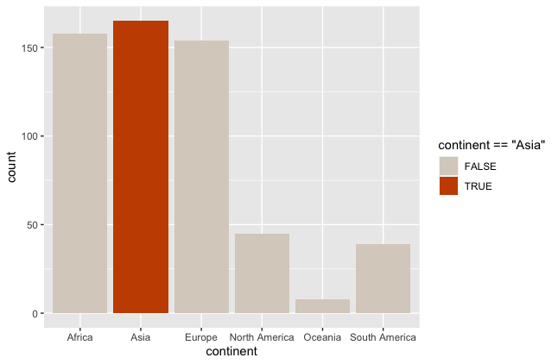
Custom Scales
ggplot(happy, aes(GDP, happiness))+
geom_bar(aes(col=continent==‘Asia’))+
scale_fill_manual(value = DukeColors)
Notes:
USE A DIFFERENT EXAMPLE. Add slides showing how you can use neutral and highlight colors

Slide 67
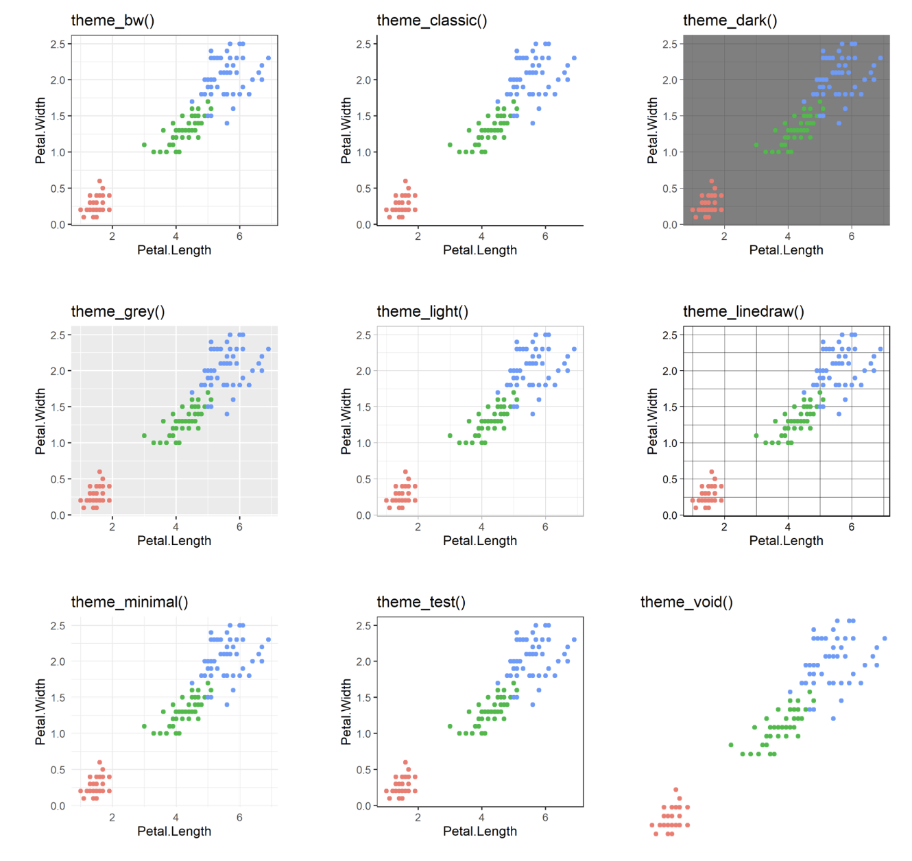
60 preexisting themes
easy to call
Data
Aesthetics
Geometries
Statistics
Scales
Themes
Exporting

Slide 68
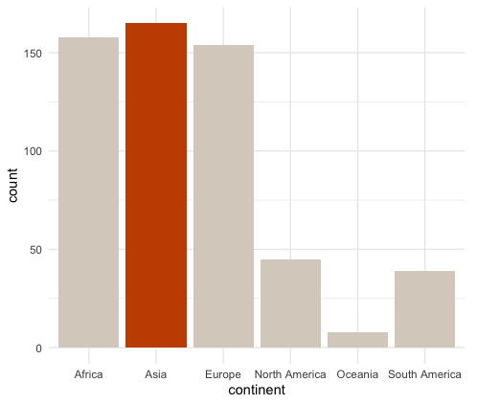
ggplot(happy, aes(GDP, happiness))+ geom_bar(aes(col=continent==‘Asia’))+
scale_fill_manual(value = DukeColors)
ggplot(happy, aes(GDP, happiness))+ geom_bar(aes(col=continent==‘Asia’))+
scale_fill_manual(value = DukeColors)+
theme_minimal()

Slide 69
60 preexisting themes
easy to call
Data
Aesthetics
Geometries
Statistics
Scales
Themes
Exporting

Slide 70
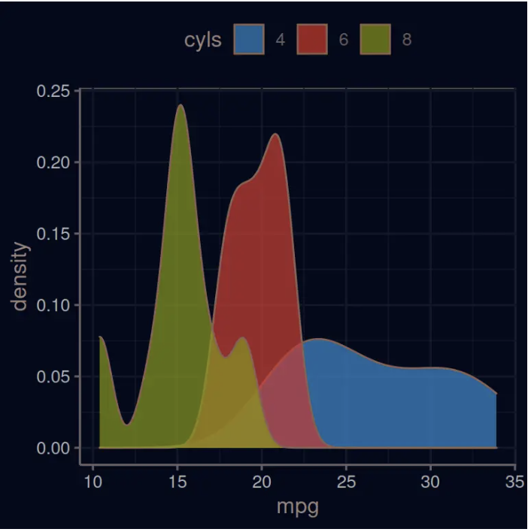
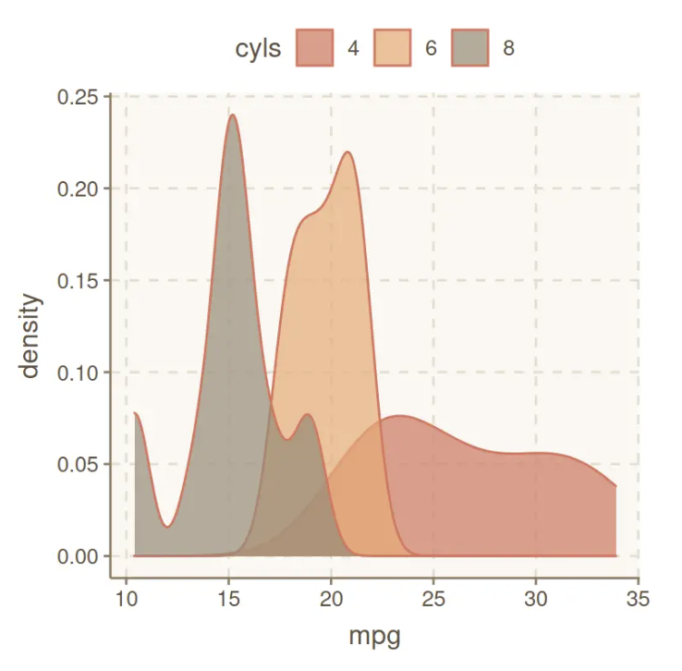
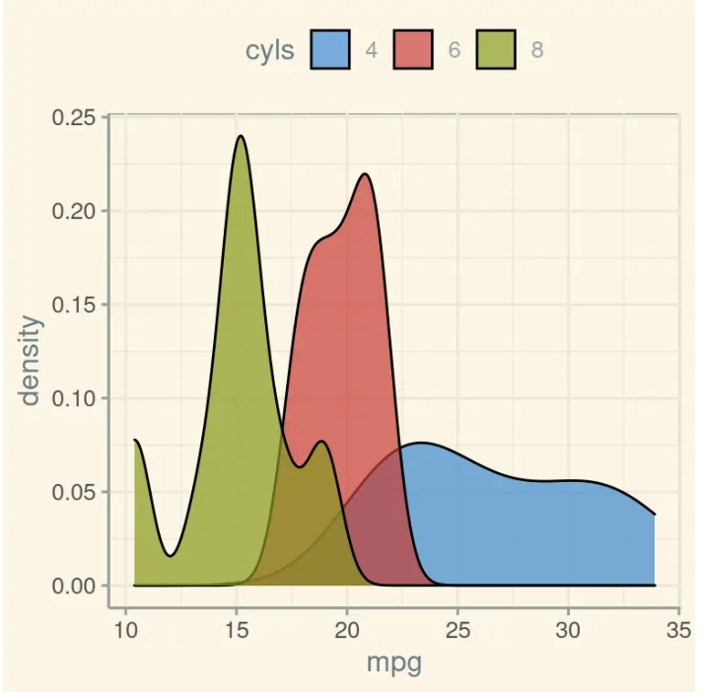
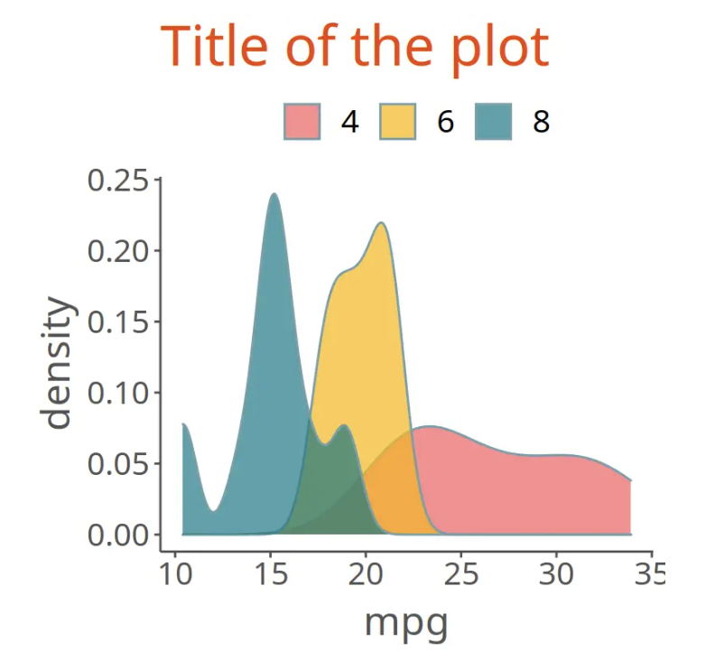
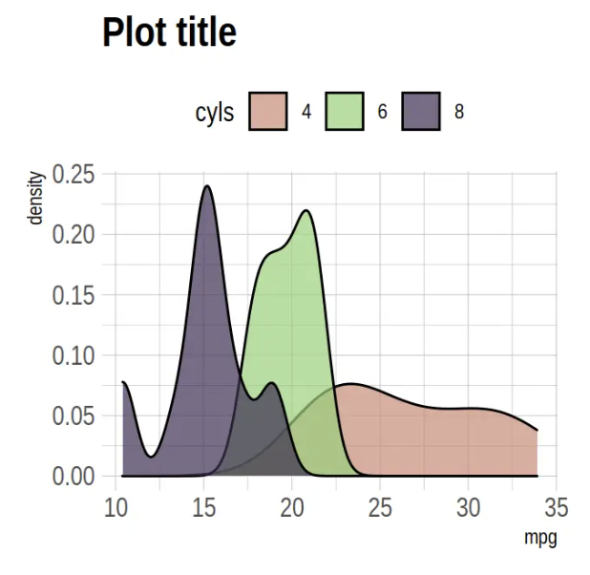
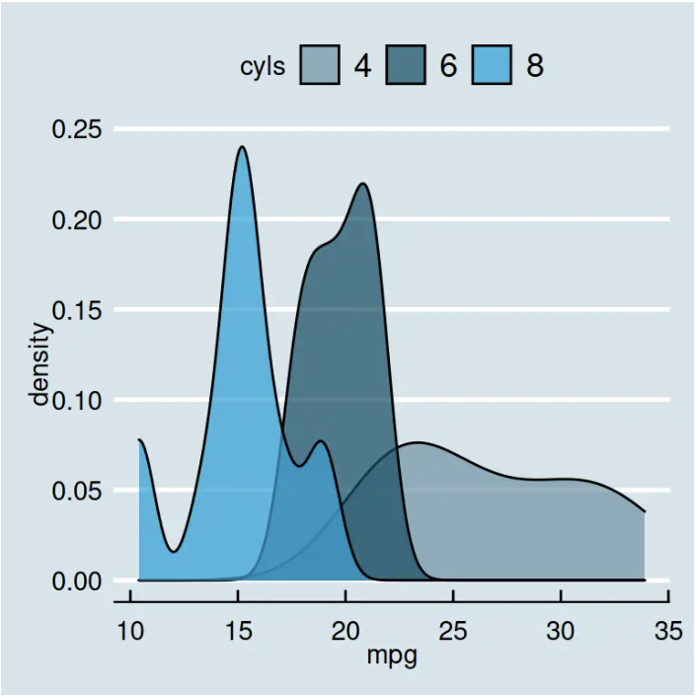
Over 60 pre-existing themes
Data
Aesthetics
Geometries
Statistics
Scales
Themes
Exporting
https://r-charts.com/ggplot2/themes/

Slide 71
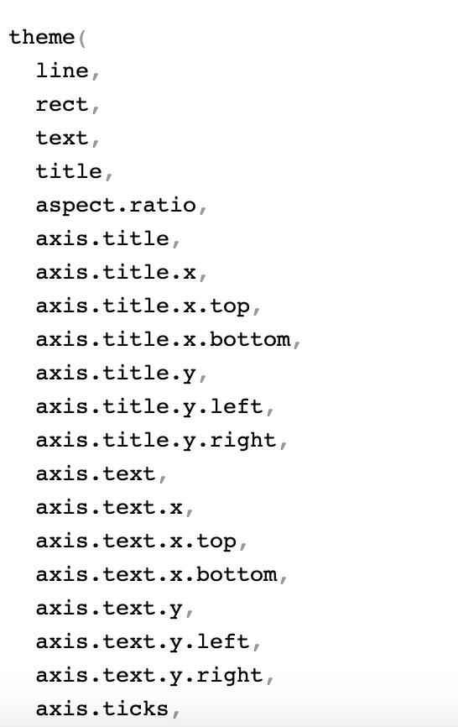
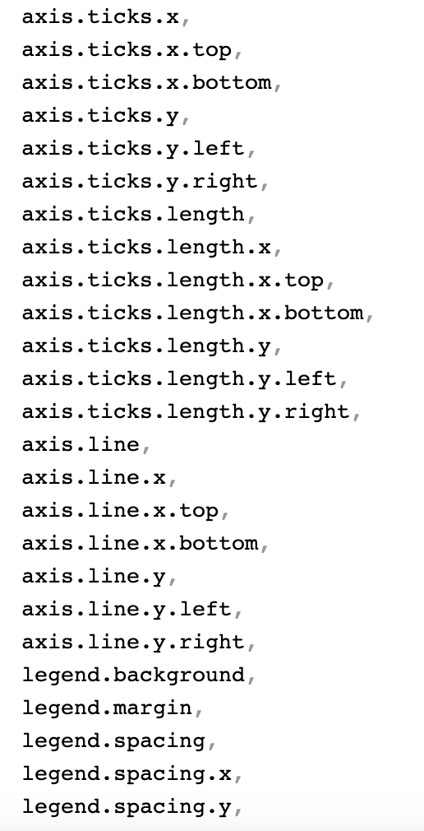
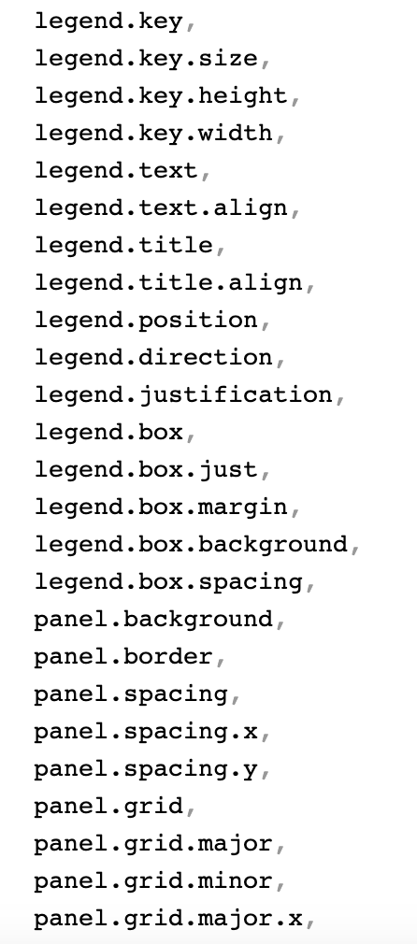
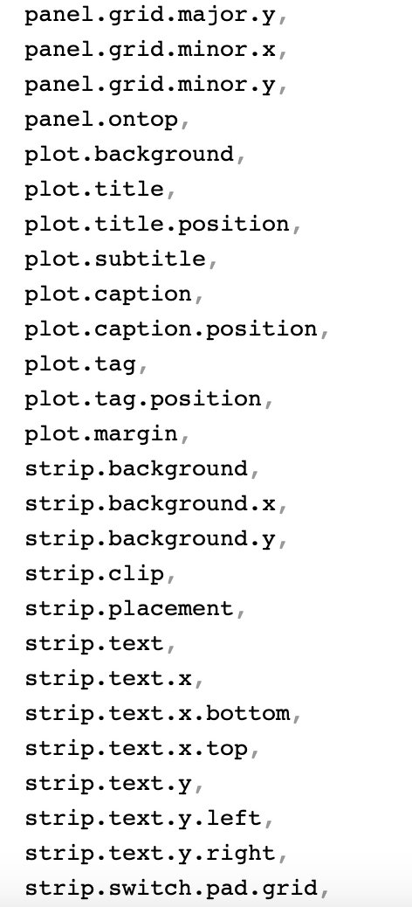
?theme()
…

Slide 72
ggplot(happy, aes(GDP, happiness))+ geom_bar(aes(col=continent==‘Asia’))+
scale_fill_manual(value = DukeColors)+
theme_minimal()

Slide 73
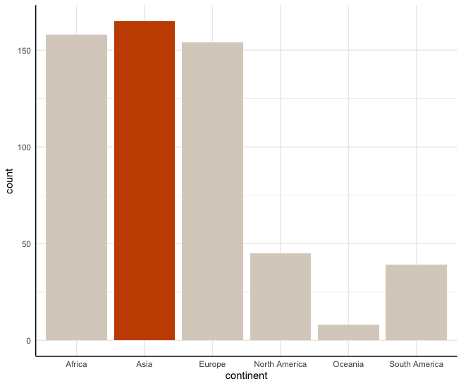
ggplot(happy, aes(GDP, happiness))+ geom_bar(aes(col=continent==‘Asia’))+
scale_fill_manual(value = DukeColors)+
theme_minimal()+
theme(axis.line.x.bottom=element_line(),
axis.line.y.left=element_line())

Slide 74
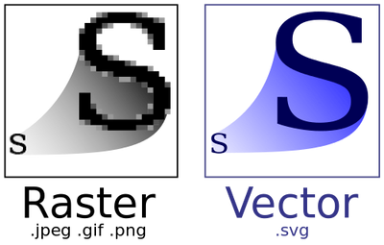
Data
Aesthetics
Geometries
Statistics
Scales
.pdf
Themes
Exporting

Slide 75
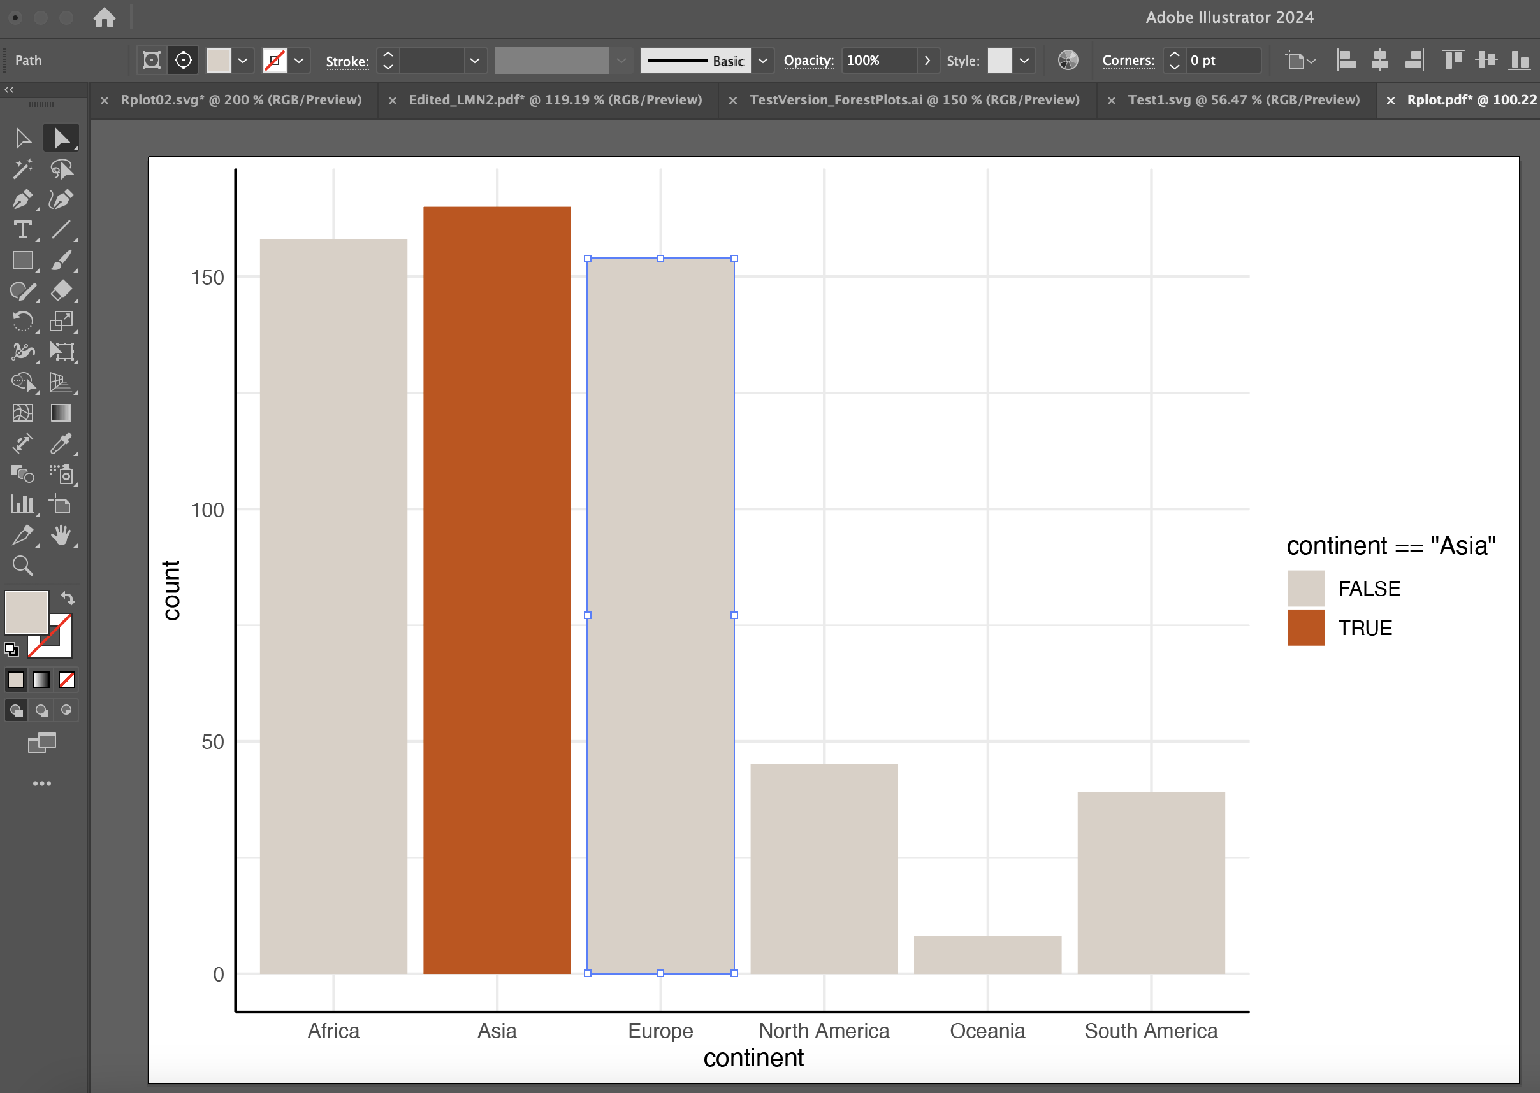

Slide 76
Lets give it a try
https://tinyurl.com/ggplot2mids

Slide 77


